Slide 1
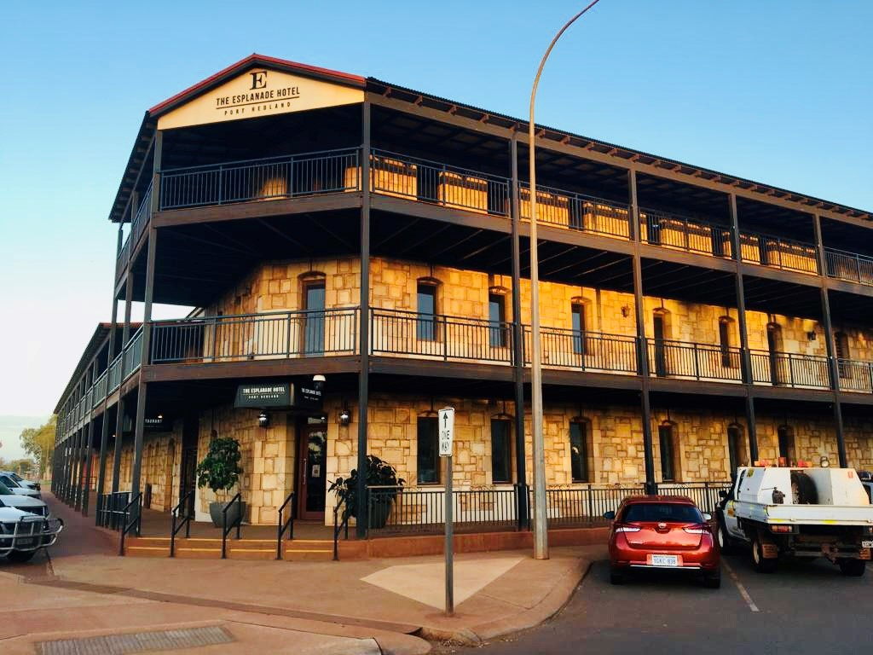
The Esplanade Hotel, Port Hedland – Façade Cladding Remediation
Development APPLICATION REPORT (WAPC)

Slide 2
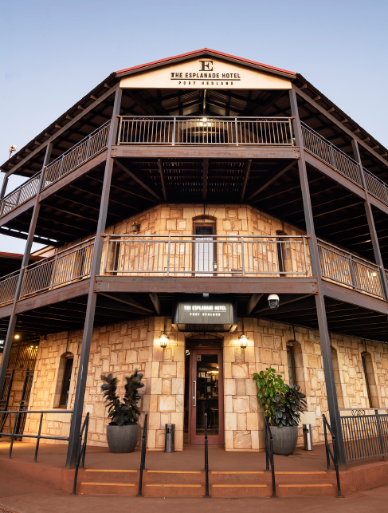
Introduction
The Esplanade Hotel, Port Hedland Façade Cladding Remediation
DESCRIPTION
The original Esplanade Hotel is a significant building in Port Hedland dating back to 1904.
It is significant as the last of the original three hotels in Port Hedland.
It anchors a primary town centre location, opposite the Port entry, and makes a significant contribution to the heritage history, character and streetscape of Port Hedland.
ISSUES
The Hotel’s external façades were clad with a new stone veneer in 2007 and 2012 prior to BHP’s purchase of the property. Since then, various stone patches have delaminated and fallen off the building.
This presentation discuss the key issues, provides identified solution options and makes recommendation.
CURRENT HERTITAGE STATUS
The Esplanade Hotel is on the State Heritage Office Database – Place Number 05946. Hedland The Esplanade Hotel is not on the register of heritage places.
It is significant as the last of the original three hotels in Port
It The Hotel has Social and Historical Significance as noted in the criteria for registration, however the large amount of alterations and additions over the years, and the cladding of the building in 2007 and 2012, have reduced the significance of the original building.

Slide 3
Current heritage status
The Esplanade Hotel, Port Hedland Façade Cladding Remediation
State Heritage Office inHerit Record
State Heritage Office inHerit Record

Slide 4
Current heritage status
The Esplanade Hotel, Port Hedland Façade Cladding Remediation
Heritage Council of WA Places Data Base Entry
Heritage Council of WA Places Data Base Entry

Slide 5
Current heritage status
The Esplanade Hotel, Port Hedland Façade Cladding Remediation
Heritage Council of WA Places Data Base Entry

Slide 6
Town of port hedland municipal inventory
The Esplanade Hotel, Port Hedland Façade Cladding Remediation
The Esplanade Hotel is significant as the last of the original three hotels in Port Hedland and for its continuous hotel and hospitality trade since 1904.
It anchors a primary town centre location, opposite the Port entry, and makes a significant contribution to the heritage history, character and streetscape of Port Hedland
Grade B Town of Port Hedland “Heritage List”. Retain and Conserve.
Architectural Style Federation Filigree (originally).
Condition Good
Integrity High Continuous hotel and hospitality
Authenticity Low
Enquiries have been made to the Town of Port Hedland for heritage records, maps and plans of the Hotel, along with recent (2013) additions . The Town have advised that all records about the Esplanade and many other buildings were destroyed in a fire that destroyed the Town’s archives.
Town of Port Hedland Municipal Inventory Entry

Slide 7
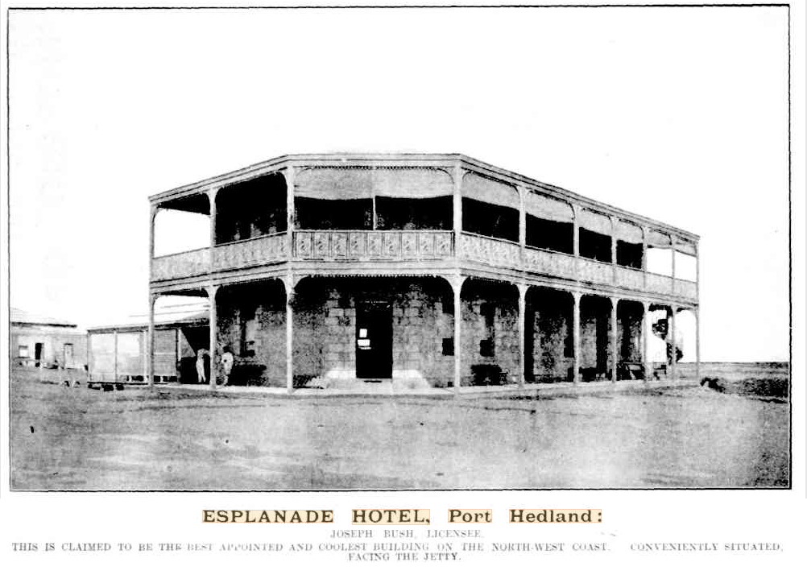
History and heritage
The Esplanade Hotel, Port Hedland Façade Cladding Remediation
From the information currently available, the Esplanade Hotel was constructed in 1904 at a cost of 5000 pounds on the corner of the Esplanade and Anderson Street, close to the original harbour and jetty. The building was constructed as a single storey stone building with timber floors, flat roof, and timber verandah to both street elevations. It was originally known as ‘McKenzies’s Hotel’ and the change in name to the Esplanade Hotel had occurred by 1910.By this time a second storey was added with external verandah with cast iron panel balustrade to the upper floor of the verandah.
It was the largest of a number of hotels in the town and one of the most prominent buildings in Port Hedland at that time. Photographic evidence indicates that by 1910, the building had a simple parapet concealing the roof with a large sign ‘Esplanade Hotel’ on the parapet.
A number of outbuildings were constructed on the north and west sides of the building after its construction.

Slide 8
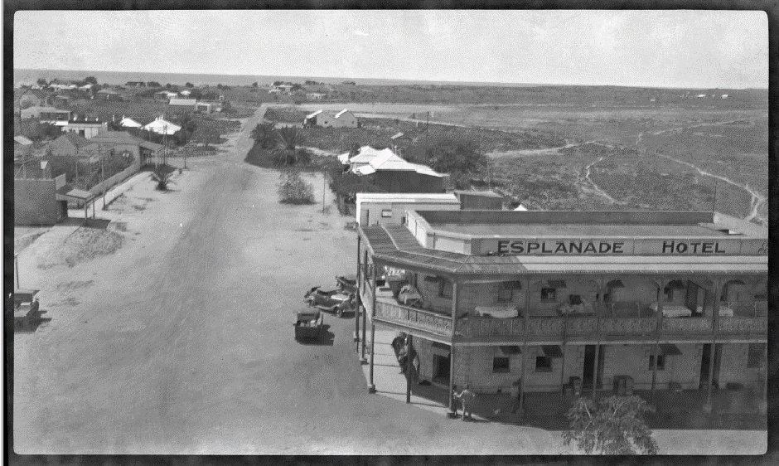
History and heritage
The Esplanade Hotel, Port Hedland Façade Cladding Remediation
Circa 1920’s, a single storey timber building was added on the Anderson Street boundary. This was later replaced with a brick building with street verandah separated from the original hotel building by a ‘breezeway’ of approx. 3m.
Photo no. 2 - Esplanade Hotel in 1937 before 1939 cyclone

Slide 9
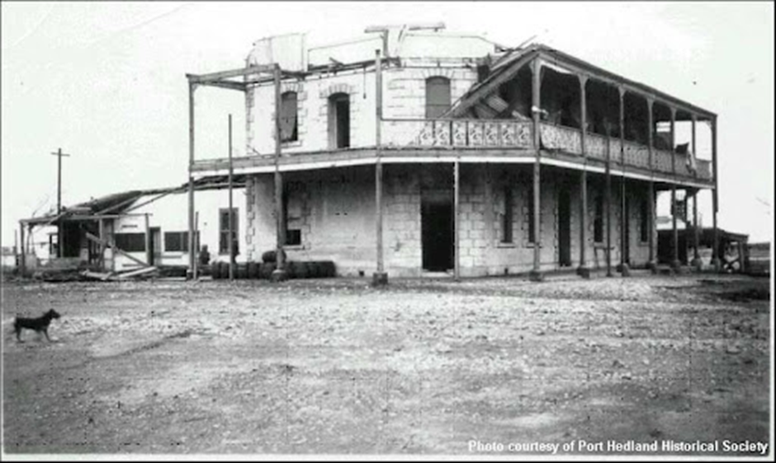
History and heritage
The Esplanade Hotel, Port Hedland Façade Cladding Remediation
The building was damaged by cyclone in 1939 and repairs and additions were constructed at this time. A second storey addition was added to the building attached to the Hotel facing Anderson Street.
Photo no. 3 - Esplanade Hotel after Cyclone damage - 1939

Slide 10
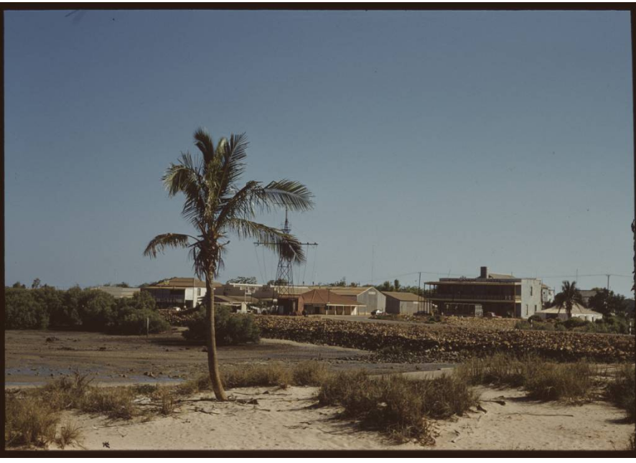
History and heritage
The Esplanade Hotel, Port Hedland Façade Cladding Remediation
Photo no. 4 - Esplanade Hotel viewed from Port Hedland harbour - 1963

Slide 11
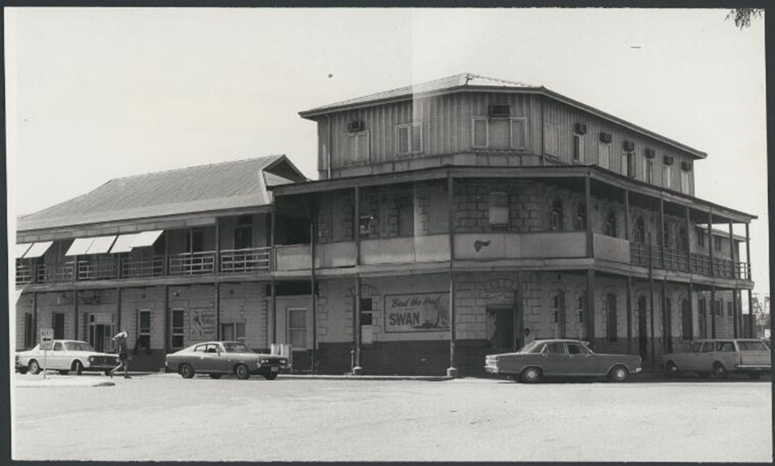
History and heritage
The Esplanade Hotel, Port Hedland Façade Cladding Remediation
Further additions to the original Hotel building occurred post WW2, with a third storey in lightweight construction and vertical asbestos cladding was added to the original hotel building in the 1960’s. Around this time a two-storey brick addition was added to the south end of the original building. Additions and extensions also occurred to the building Anderson Street, which extended as a two-storey building to the ROW on the east boundary by the 1970’s.
Photo no. 5 - Esplanade Hotel before second cyclone damage – 1970’s

Slide 12
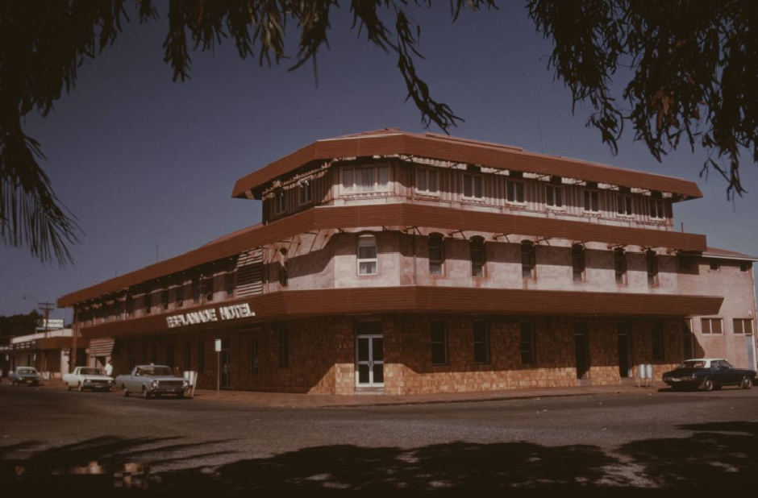
History and heritage
The Esplanade Hotel, Port Hedland Façade Cladding Remediation
In the 1970’s the Hotel was again damaged by a cyclone event and the timber verandah of the original hotel and addition were replaced with steel framed awnings on both street elevations, which visually unified the buildings.
Photo no. 6 - Esplanade Hotel after second cyclone damage – 1970’s

Slide 13
History and heritage
The Esplanade Hotel, Port Hedland Façade Cladding Remediation
In 2013 a major redevelopment of the Esplanade Hotel occurred with the construction of a new 3 storey steel framed extension of the hotel on the south end of the original hotel which continued along the south boundary of the site, along street boundary of the Esplanade. This addition included a new steel framed 3 storey verandahs over the boundary on both street elevations and a similar 3 storey verandah on the inside (north and east sides) of the new building. The new building was clad externally with a prefabricated stone cladding in random ashlar pattern to all external faces of the new building (excepting fire escape shafts). The stone cladding was adhered to a compressed sheet lining of the external walls. The stonework cladding was well detailed and included quoining on corners and around window and door openings.
It is understood anecdotally that in 2007 the stone cladding was first applied to the original 1904 building. , presumably in 2013, the same stone cladding was applied to new additions and the buildings on Anderson Street to unify the new additions with the original hotel building. From investigation of the original buildings, a compressed sheet lining was applied over the original façade fixed off furring channels with prefabricated stone cladding in random ashlar pattern that matches the stone veneer cladding added to the 2013 additions. New steel verandahs of a similar detail to the new extension were also added to the existing hotel on the Anderson Street and Esplanade elevations.

Slide 14
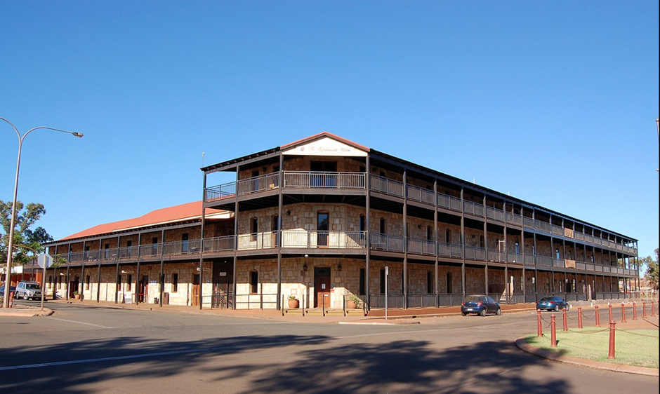
History and heritage
The Esplanade Hotel, Port Hedland Façade Cladding Remediation
Photo No. 7- Esplanade Hotel in 2017 -after 2013 alterations and additions
In Since the Esplanade Hotel was purchased by BHP in 2018, stone cladding pieces have de-laminated from the sub-structure and fallen off. This situation has prompted this investigations and report.

Slide 15
Development stages
The Esplanade Hotel, Port Hedland Façade Cladding Remediation
From current information, the Esplanade Hotel developed from its construction to the present day in the following stages and approximate dates:
1904-1910 Original single storey stone building with timber verandah constructed , second storey added
1915- 1920’s Single storey timber building constructed on Anderson Street with timber verandah onto the street
1920’s Construction of single storey brick building replacing earlier timber building on Anderson Street with breezeway to hotel
1939 Cyclone damage to buildings. Repairs and additions
Post WW2-1960 Second storey addition and extension to northern building on Anderson Street with street verandah.
1960’s Lightweight third storey addition with vertical cladding added over original hotel only
1970’s Damage by another cyclone resulted in removal of verandahs and replacement with steel awnings to the length of the building on both street elevations, and 2 storey masonry extension to the south end of the original 1904 building.
1980’s- 2007 Anecdotally, the 1904 original hotel is clad with stone cladding.
2013 Major redevelopment of the existing buildings and construction of new 3 storey wings to the south and west around the Esplanade. Construction of new steel framed verandahs to full length of The Esplanade and Anderson streets. Refurbishment of existing rooms and the bars to the existing hotel. Random ashlar prefabricated stone cladding fixed to new and existing buildings to provide a unified total complex.

Slide 16
Heritage significance
The Esplanade Hotel, Port Hedland Façade Cladding Remediation

Slide 17
Heritage significance
The Esplanade Hotel, Port Hedland Façade Cladding Remediation

Slide 18
Heritage significance
The Esplanade Hotel, Port Hedland Façade Cladding Remediation

Slide 19
Heritage significance
The Esplanade Hotel, Port Hedland Façade Cladding Remediation
Listing:
The Esplanade Hotel is on the Heritage Council of WA Database (Place No. 05946), but is not a ‘Registered Place ‘(No Statutory Listing).
The Esplanade Hotel was placed on the Town of Port Hedland Municipal Inventory in 1996 with a ‘Category 2’ category of significance.
The Esplanade Hotel was adopted onto the Town of Port Hedland Heritage List in 2017.
Statement of Significance:
Esplanade Hotel is significant as the last, of the original three hotels in Port Hedland, and for its continuous hotel and hospitality trade since 1904. It has been a landmark to people of Port Hedland town during that time. (Historic Significance).
Constructed at a cost of £5000, McKenzie’s Hotel (later known as the Esplanade Hotel) was the most prestigious of Port Hedland’s 3 hotels in the 1900s. The hotel was the focus of many social occasions, and since 1904 has offered hospitality to generations of travellers.’ (Social Significance)

Slide 20
Stages of significance
The Esplanade Hotel, Port Hedland Façade Cladding Remediation
The Esplanade Hotel has undergone many changes and additions over its life. These all contribute to the history of the place and have various levels of significance. Much of the significance of the early buildings is concealed by the uniform cladding fixed over all parts of the building in 2007 / 2013. Highlighting the early sections of the Esplanade hotel would assist in its interpretation.
Based on documentary & physical evidence available, the stages of significance are:
Highest Significance:
Remains of the original 1904 building and circa 1910 second storey addition to the original building, including original parapet (concealed on 3rd floor)
High Significance:
Remains of the circa1920’s building (brick construction) on Anderson Street separated from the original Hotel by a breezeway
Some Significance:
Remains of construction from 1939-40 after Cyclone damage
Little Significance:
3rd floor framed addition on top of original building, 1970’s brick addition to southern end of original building
No Significance:
Additions and alterations made in 2013 and after

Slide 21
Heritage recommendations
The Esplanade Hotel, Port Hedland Façade Cladding Remediation
Since original construction in 1904 the Esplanade Hotel had developed and grown in a number of stages, reflecting growth and change in the town of Port Hedland. Prior to 2013 the building had a mixed aesthetic where various stages of development were discernible. Early attempts to unify the building included red ochre paint finish over the facade and in the 1970’s linear awnings replaced verandahs and wrapped around both street facades.
The most recent development in 2013 significantly extended the building and increased its height to 3 storeys on all The Esplanade boundaries. At this time stone cladding was applied to the new addition and all faces of the original buildings. This effectively unified the facades of the whole building, but at the same time concealed heritage fabric and the possibility of interpretation of the history of the Hotel.

Slide 22
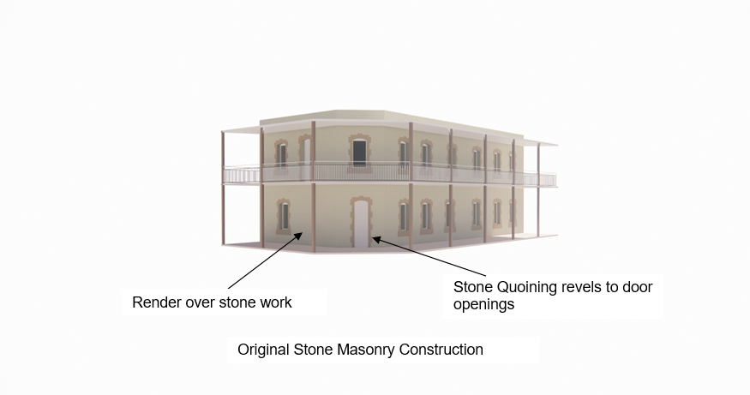
Historical staging diagrams
The Esplanade Hotel, Port Hedland Façade Cladding Remediation
1904 - 1920

Slide 23
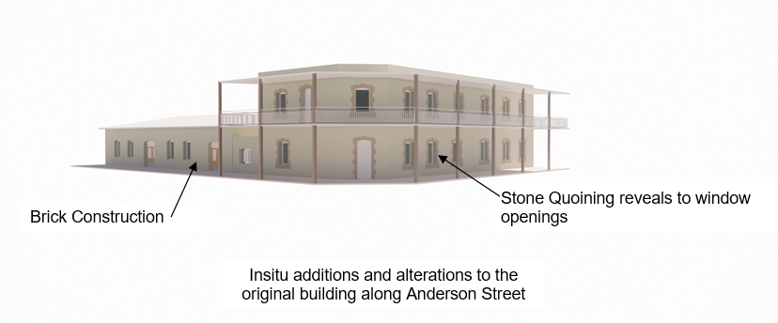
Historical staging diagrams
The Esplanade Hotel, Port Hedland Façade Cladding Remediation
1920’s

Slide 24
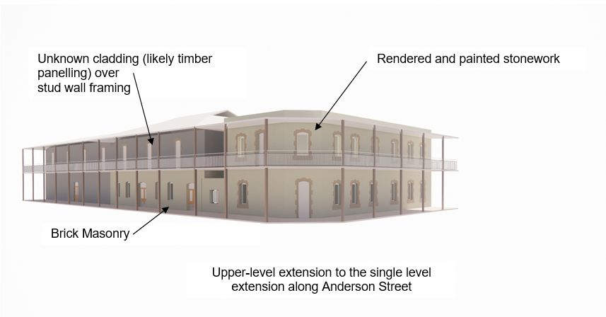
Historical staging diagrams
The Esplanade Hotel, Port Hedland Façade Cladding Remediation
Post WW2-1960

Slide 25
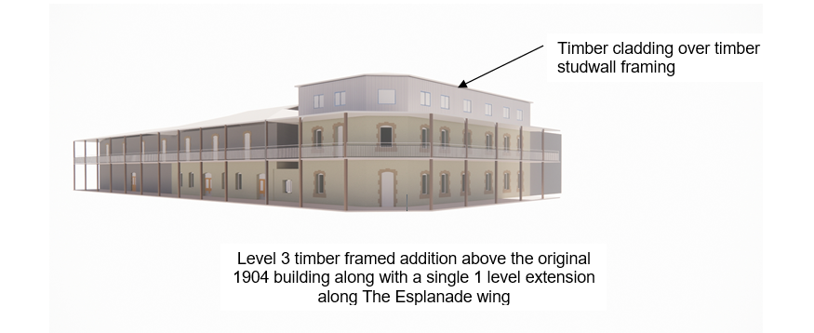
Historical staging diagrams
The Esplanade Hotel, Port Hedland Façade Cladding Remediation
1960’s

Slide 26
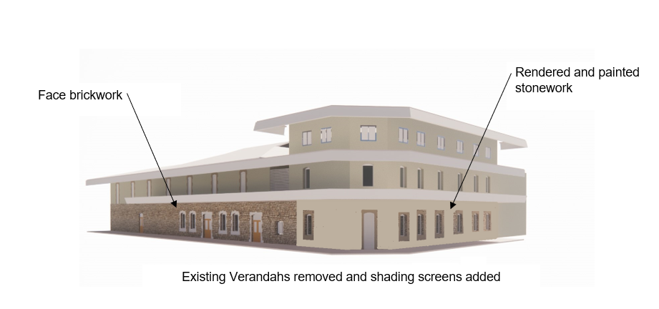
Historical staging diagrams
The Esplanade Hotel, Port Hedland Façade Cladding Remediation
1979

Slide 27
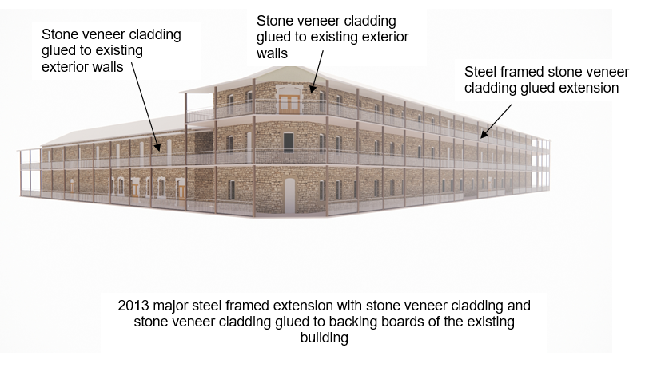
Historical staging diagrams
The Esplanade Hotel, Port Hedland Façade Cladding Remediation
2013

Slide 28
Heritage initiatives
The Esplanade Hotel, Port Hedland Façade Cladding Remediation
Express the heritage significance of the 1904 building:
Different wall finish with lighter cream tone indicative of original light building colour per 1900-1940s building photograph
Bold treatment of door and window reveals for aesthetic interest to 1904 and 1940 Anderson Street Facade
Recommendations for Heritage Interpretation of the Esplanade Hotel:
Design to be based on historical evidence and to respect the heritage value of the building, to tell the story of the building development over time
The Burra Charter article 22 notes ‘New work is acceptable where it does not obscure the cultural significance of the place, or detract from its interpretation’
Interpretation plan to be developed as part of the works –design and fabricate story boards to be installed at strategic places throughout the Hotel
Written and photographic information displayed on interpretation panels to tell the story of the hotel and its historical significance to the people of Port Hedland
Video/internet based publication played in hotel public spaces and rooms. Add video to hotel website and provide copy to Town of Port Hedland and Port Hedland Historical Society/museum to promote hotel history
Note – the stone cladding currently on the Esplanade Hotel is not historically significant or of any heritage value

Slide 29
The Esplanade Hotel, Port Hedland Façade Cladding Remediation
PROPOSED PERMANENT REMEDIATION PROPOSAL:
Remove all stone cladding and replace with new acrylic rendered cladding
PROS
High heritage alignment
Colour theming for street character
Natural stone colour to align with 1904 building
Contrasting stone colours to addition to building
Permanent Solution
Remove risk
Warranty
Expansion joints added for longevity of solution
Economical
Quicker execution duration
CONS
Specialist installer required
Cladding could potentially finish 25mm beyond existing stone veneer cladding

Slide 30
Recommendation
The Esplanade Hotel, Port Hedland Façade Cladding Remediation
The recommended permanent remediation proposal comprises :
Remove all existing stone and backing board
Replace existing furring channels . Install new construction / movement joints. Install new backing boards
Install missing thermal insulation and vapour barriers
Apply 3 coat rendering system by trained applicator
Stone details to window and door reveals to 1904 -1940 high significance buildings only , and pre-finished ‘charcoal grey’ powdercoat linings to all other areas of existing buildings.
Reasons
High heritage value. Provides the opportunity to interpretate the remains of the 1904 -1940 building, with stone veneer detailing to door and window reveals
Colour theming of 1904 - 1940 and remaining sections can communicate in a visual manner the historical development progression of the hotel for 1904 to 2013
Ability to add a new vapour barrier and thermal insulation if required to address current condensation issues in the building.
The recommended Interpretation Plan comprises :
Development of Interpretation Plan to be based on historical evidence and to respect the heritage value of the building, to tell the story of the building development over time

Slide 31
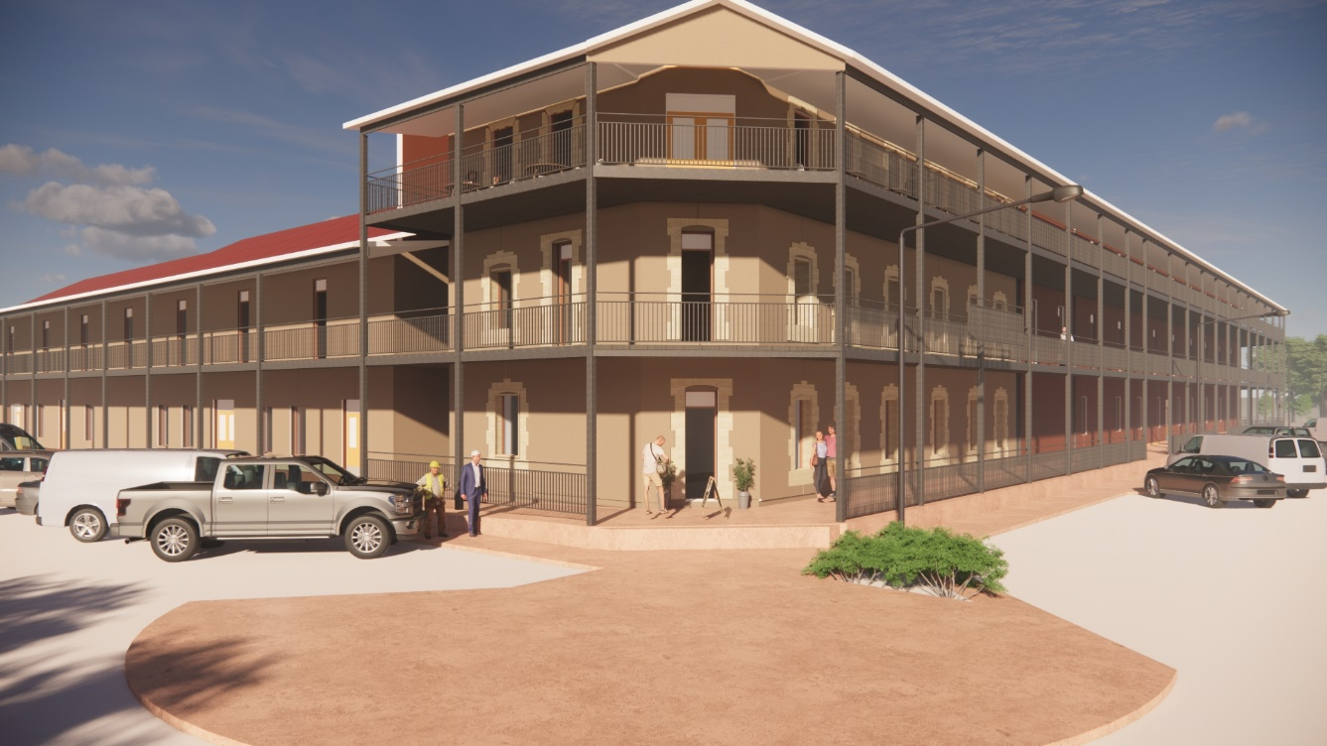
The Esplanade Hotel, Port Hedland Façade Cladding Remediation
artists impression - ANDERSON STREET
View from Anderson Street

Slide 32
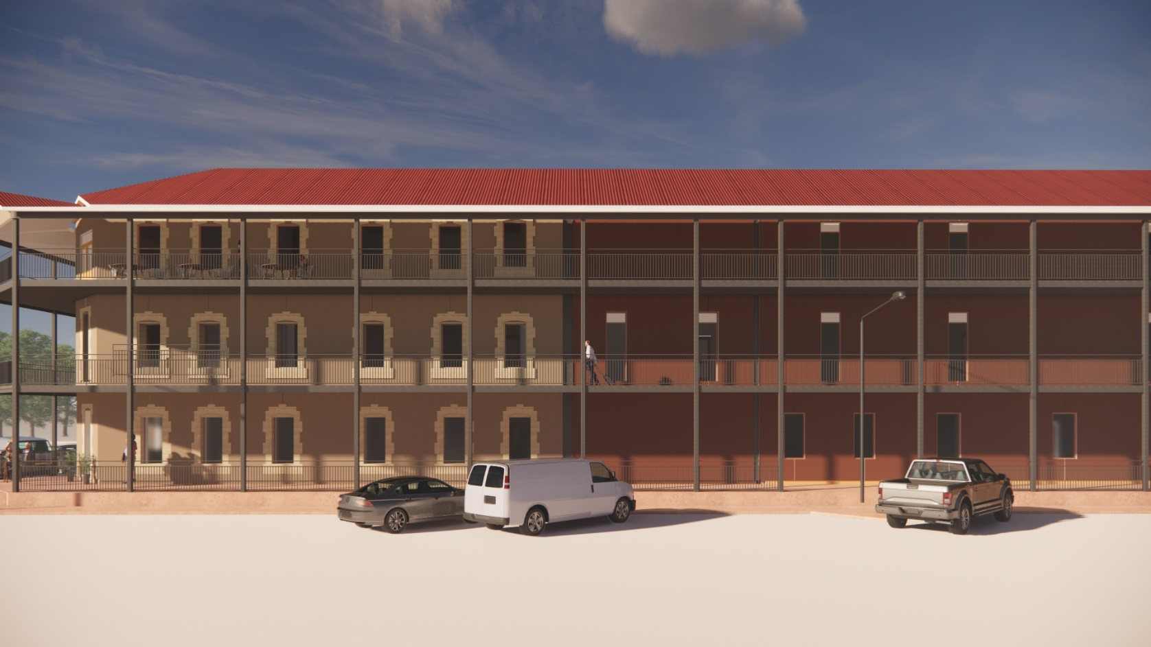
The Esplanade Hotel, Port Hedland Façade Cladding Remediation
artists impression – THE ESPLANADE
View from The Esplanade

Slide 33
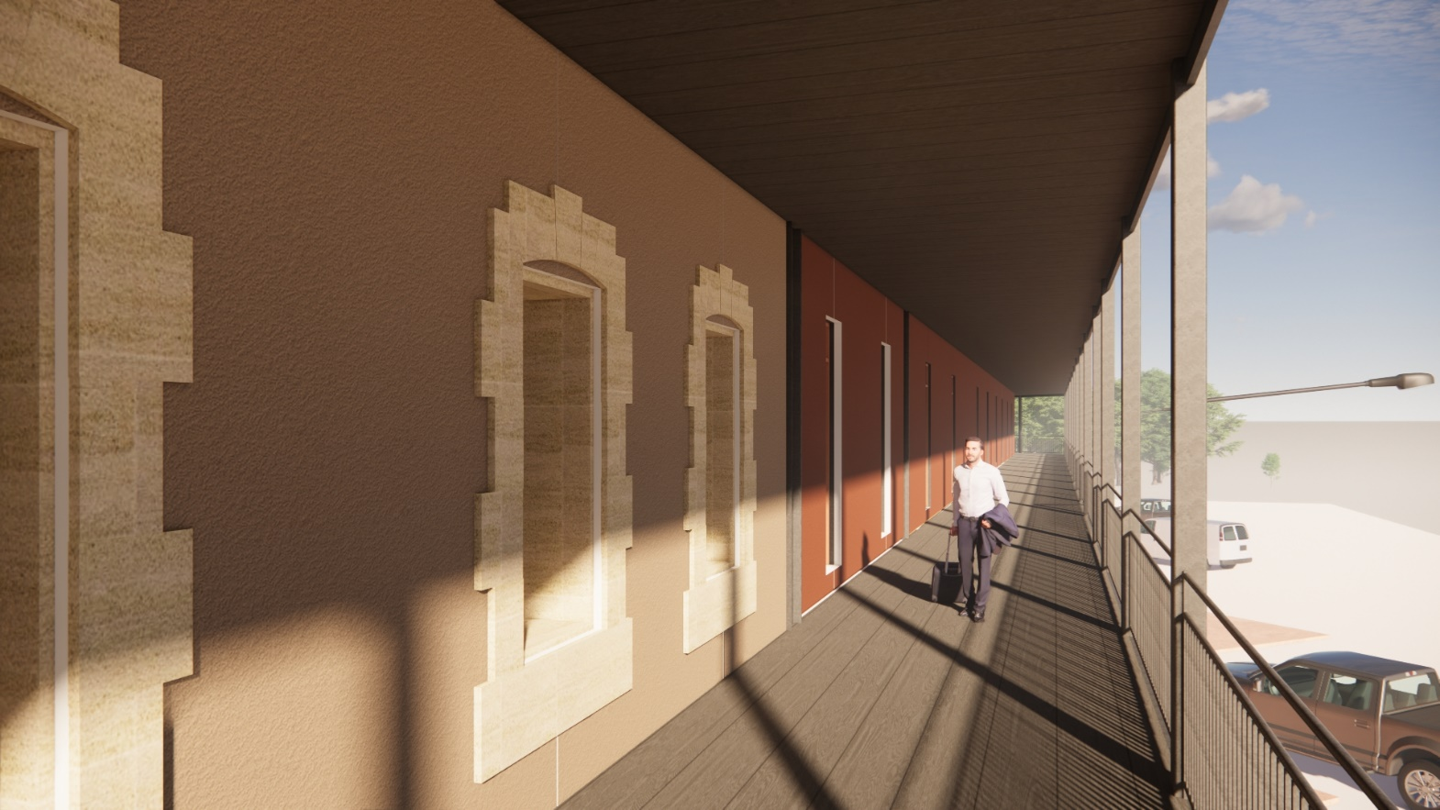
The Esplanade Hotel, Port Hedland Façade Cladding Remediation
artists impression – DETAIL OF JOINT BETWEEN SECTIONS
Close up view of heritage differentiation

